Slide 1
Coursera Capstone Project

Slide 2
Introduction and Data
This task is based on a synthesised transaction dataset containing 3 months’ worth of transactions for 100 hypothetical customers. It contains purchases, recurring transactions, and salary transactions.

Slide 3
Methodology
Main goal is to check whether there are any data issues or the data need to be cleaned.After that gathered some interesting overall insights about the data. For example -- what is the average transaction amount? How many transactions do customers make each month, on average? After that,segmented the dataset by transaction date and time. Visualised transaction volume and spending over the course of an average day or week. Considered the effect of any outliers that may distort your analysis. Explored correlations between annual salary and various customer attributes (e.g. age). These attributes could be those that are readily available in the data (e.g. age) or those that you construct or derive yourself (e.g. those relating to purchasing behaviour). Visualised any interesting correlations using a scatter plot. Built a simple regression model to predict the annual salary for each customer using the attributes you identified above

Slide 4
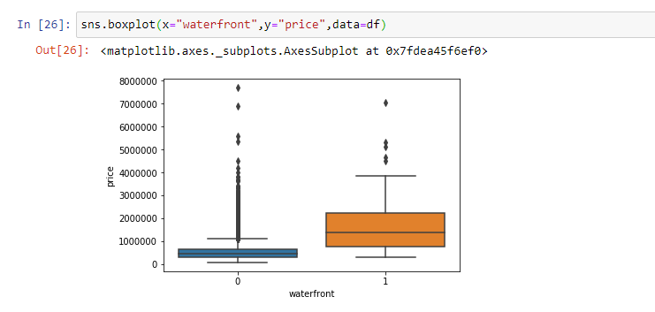
Analysis

Slide 5
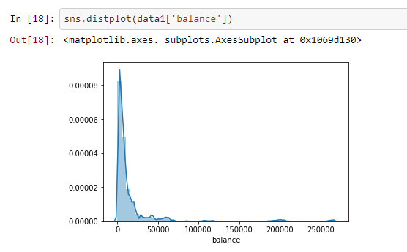

Slide 6
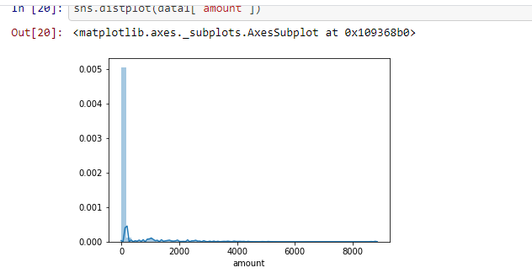

Slide 7
